Slide 1

The Future is Now
Enterprise Application Management and Cloud PKI in the Intune Suite

Slide 2
Who am I?

Slide 3

Microsoft Intune plans
Intune Suite
Add to Plan 1 to utilize these solutions*
Remote Help
Endpoint Privilege Management
Advanced Analytics
Enterprise Application Management
Cloud PKI
All Intune Plan 2 features
Prerequisite
Intune Plan 1
Intune Plan 1
Included in EMS E3 or Microsoft 365 E3, ME5, F1, F3, and Business Premium plans
Cross-platform endpoint management
Endpoint security built in
Endpoint analytics
App protection policies
Shared device management
Device compliance
Risk and app based conditional access
Proactive remediation
Integrated Microsoft 365 and security
Intune Plan 2
Add to Plan 1 to utilize these features
Tunnel for Mobile App Management
Mobile firmware update management
Specialty device management
Multiple managed accounts (future)
Prerequisite
Intune Plan 1
*Also available as individual add-ons
aka.ms/IntuneSuitePricing
Notes:
Slide Objective: Enabling cost savings—integrated value and flexibility.
Talk Track:
Many C-Suite executives are looking for cost savings—the Intune Suite delivers multiple ways to save.
Intune Suite reduces the overhead of negotiating and overseeing separate contracts with multiple vendors.
Intune Suite bundled list price is lower than the sum of all the individual capabilities.
Delivers Microsoft integrated value greater than the cost and overhead of managing alternative vendor solutions.
The bundle is available as an add-on to any plan that includes Intune, which most customers get through the value of their Microsoft 365 subscription.
For added flexibility, the individual solutions within the suite will also be available as standalone add-ons to Intune, so organizations can migrate to the Microsoft solution they prioritize based on their needs.
Next slide

Slide 4


Enterprise Application Management
Supports: Windows
Proactively, simply, and securely deploy and manage apps
Reduce time and effort for IT administrators to package apps and track updates while streamlining fix deployments to keep apps up to date and secure.
78%
of devices remain unpatched nine months after the release of a patch fixing a critical vulnerability.
Streamline application management.
Reduce security risks and vulnerabilities.
Stay current with updates and alerts.
Source: Microsoft Digital Defense Report 2022.
Notes:
Slide Objective: Deep dive: Enterprise Application Management—Proactively, simply, and securely deploy and manage apps.
Talk Track:
The initial release of our advanced application and patch management solution offers a new enterprise app catalog. This catalog is hosted by Microsoft and will eventually contain over 500 1st- and 3rd-party apps.
The solution will help IT save time by streamlining the process of discovering and packaging apps.
Streamline application management: Reduce complexity of managing Microsoft and 3rd-party apps across your organization by streamlining the process of discovering, packaging, and updating apps directly from the Microsoft Intune console.
Reduced security risks and vulnerabilities: Deploy app fixes quickly to mitigate risk immediately with proactive discovery of security vulnerabilities.
Stay current with updates and alerts: Keep apps up to date and secure by proactively identifying and updating them using update notification and guided updating.
Next slide

Slide 5


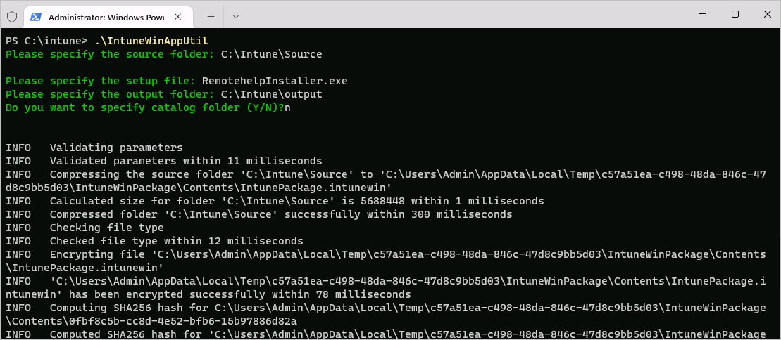
Application management takes too much effort
Application packaging is . . .
time consuming
too much work
doesn’t have what I need
tedious
archaic
clunky
cumbersome

Slide 6
Today we’re focused on building the foundation
The foundation is the Enterprise App Catalog
A guided upgrade experience
Includes a prioritized set of pre-packaged applications
Support for managed applications

Slide 7


Enterprise Application Management snapshot
Enterprise App Catalog
Securely hosted Enterprise App Catalog for Microsoft and non-Microsoft applications
Prepackaged and preconfigured apps
No wrapping, no install commands
Includes Microsoft-hosted and validated content
Enterprise App Catalog expanded to include more applications
Coming soon
Graph API scripting available with Enterprise App Catalog
Guided upgrade process to save time and resource hours
Notes:
Slide Objective: Advanced Endpoint Analytics capabilities and what’s coming.
Talk Track:
Key capabilities
With anomaly detection and enhanced device timeline, IT admins can proactively identify potential Windows device issues across their end-user computing landscape and troubleshoot them more effectively. This will help IT resolve issues in a timely manner before they impact the end-user experience and security.
Anomaly detection, an early warning mechanism for identifying issues, is always looking for changes in device behavior or unexpected signals, providing a fast, reliable, and objective indicator of potential issues.
Custom device scopes offer customers the flexibility to analyze the performance and reliability of subsets of their devices using Endpoint analytics. By leveraging the Scope tags, you can easily slice and dice the Endpoint analytics reports to get more granular insights for the devices for which you're responsible. This means you can now drill down into the performance of specific business groups or geographic regions, allowing you to identify trends and issues that may not have been visible before.
Coming soon
Looking forward, we’re excited to provide access to device inventory querying for near real-time assessment of the state of devices along with additional insights such as battery health to support sustainability goals.
Next slide

Slide 8

Cloud PKI
Supports: Windows | macOS | iOS | Android
Create multiple certificate authorities and manage certificate lifecycle in the cloud
Allow customers to create, revoke, and manage certificates using Intune, removing the cost and complexity associated with on-premise PKI infrastructure.
8.4
Average number of distinct applications PKI manages on behalf of organizations, a core element of the enterprise IT backbone.
Simplify certificate delivery.
Accelerate cloud transformation.
Improve security with certificate-based authentication.
Source: Poneman Institute, 2022 Global PKI and IoT Trends Survey.
Notes:
Slide Objective: Deep dive: Cloud PKI— Create multiple certificate authorities and manage certificate lifecycle in the cloud.
Talk Track:
Authentication with certificates is a secure and seamless experience for the user. By establishing their identity as trustworthy, devices and users can request a signed certificate enabling the user to present to other services for authentication purposes.
With Microsoft Intune Cloud PKI you can manage your cloud certificates in the same place as you manage your endpoints.
A migration from on-prem to cloud-managed certification can not only streamline processes and reduce management costs, but drastically simplify the delivery and management of certificates and enhance security without dedicated SMEs to manage.
Next slide

Slide 9

Acronyms decoder
ADCS – Active Directory Certificate Service
BYOCA – Bring Your Own Certificate Authority
CA – Certificate Authority
CBA – Certificate-Based Authentication
CDP – CRL Distribution Point
CRL – Certificate Revocation List
C-PKI – Microsoft Cloud PKI
DR – Disaster Recovery
GA – General Availability
HA – High Availability
HSM – Hardware Security Module
OPS – Operations, Operational
PKI – Public Key Infrastructure
NDES – Network Device Enrollment Service
RA – Certificate Registration Authority
RBAC – Role-Based Access Control
RSA – Rivest-Shamir-Adleman, a suite of cryptographic algorithms
SaaS – Software as a Service
SHA – Secure Hash Algorithm
SCEP – Simple Certificate Enrollment Service
WHfB – Windows Hello for Business

Slide 10







Intune today | Certificate connector or 3rd-party API
Intune
User/Device
certificates
3rd-party
PKI
Intune cert connector/ NDES/Proxy
Customer PKI
ADCS or other
User/Device
certificate
Wi-Fi, VPN
policies
Secure connect cert
User/Device cert
Wi-Fi access points
VPN servers
Applications
Intune-managed devices

Slide 11

Microsoft Cloud PKI Root CA deployment
Trusted Chain Intune C-PKI CA (root & issuing)
Root CA Cert
Issuing CA Cert
Intune MDM delivery channel
Out-of-band delivery required (GPO or other)
Trust SSL certs
Trust SCEP certs
Wi-Fi access points
VPN servers
CBA webservers
& applications
Customer PKI
SSL certs
Intune-managed devices
Note: With 3rd-party solutions, customers will need to configure relying parties to trust additional certification authorities.

Slide 12

Details
Create CA per Intune tenant
Create 2-tier PKI hierarchy
Root, issuing CA in the cloud
Support Bring Your Own CA (BYOCA)
Anchor Intune issuing CA to a private CA
Signing and encryption algorithms | RSA
RSA Key sizes – 2048, 3072, 4096
Hash algorithms – SHA-256, SHA-384, SHA-512
Providing a SCEP service per issuing CA
CRL distribution points
End-entity (leaf) certificate issuance
Protocol/Cert format – SCEP (PKCS#7)
Platforms: Intune-enrolled devices on iOS, Android, Mac, and Windows
Certificate life cycle management
Automatic and manual certificate revocation
Reporting/Dashboard
Issuing CA summary (issued, expired, revoked) and detailed information about issued certificates
Audit
Admin actions performed on the CA
RBAC permissions and scope tags

Slide 13


